Slide 1

How do helicopters fly?
By Alexander Xu

Slide 2
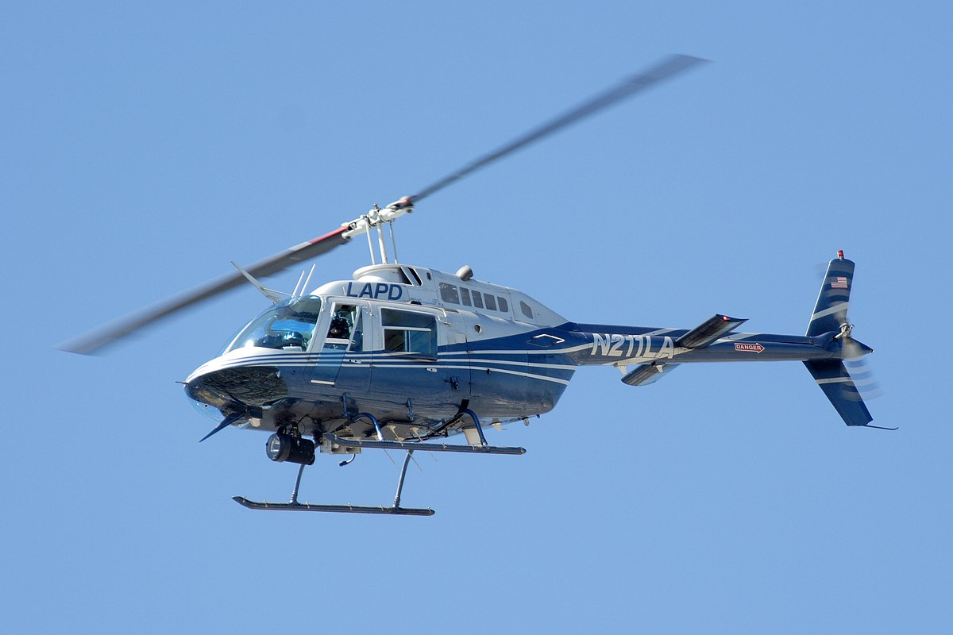
Introduction
For many centuries, humans have been chasing the concept of flight. Methods to achieve this dream evolved throughout history eventually leading to spinning wings to generate lift in helicopters. These machines allow for easy air travel, and can take off and land from anywhere. Today, helicopters are among the most popular methods of transportation.

Slide 3
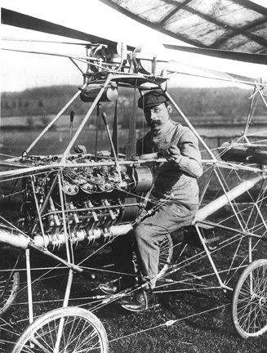
Discovery & Discoverer
On November 13 1907 (around the time Einstein published special relativity) the first successful helicopter flew… for a few seconds. French pioneer Paul Cornu invented the first working helicopter. Whilst this prototype was able to lift itself off the ground, it had to be held in position by people - it could not move by itself. Investigations into fixed wing flight and small toys that functioned like helicopters ultimately helped the invention of the helicopter.

Slide 4
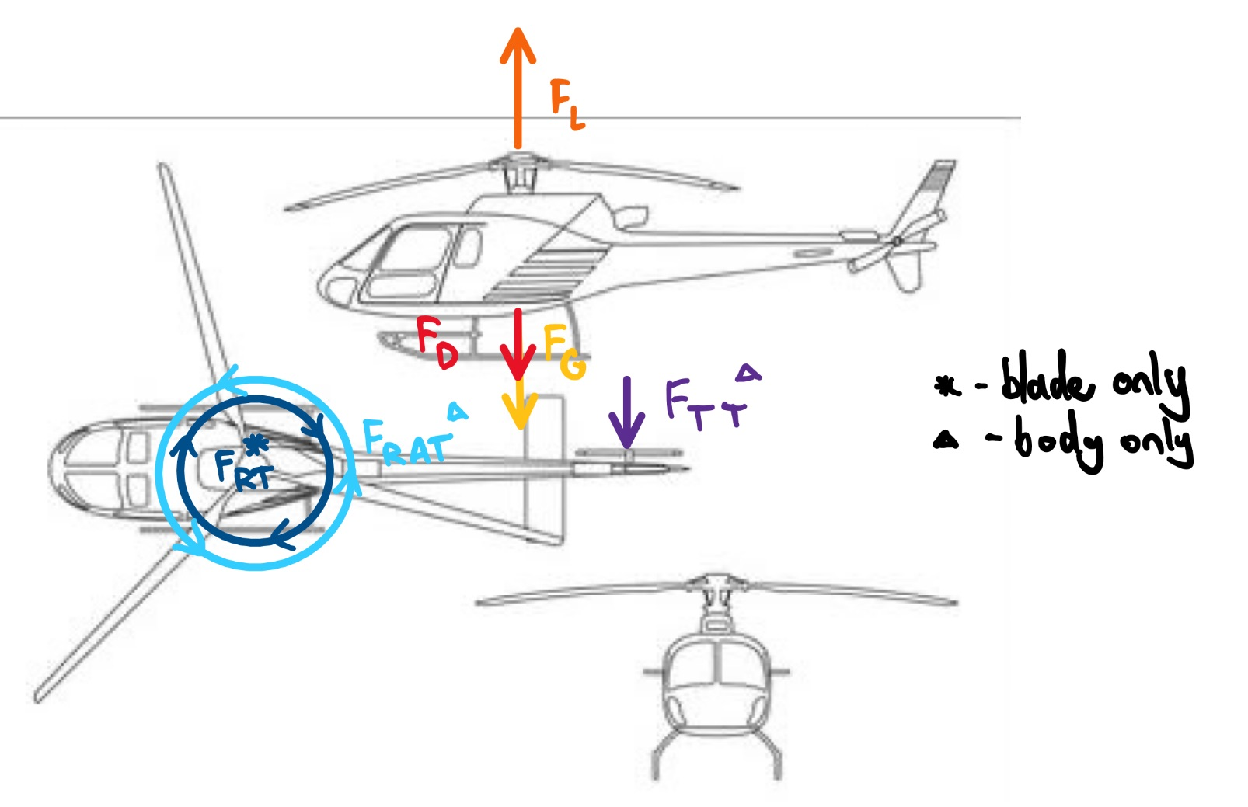
Diagram of forces (Flying up and down)
F_{L}-Lift
F_{D}-Drag/Air resistance
F_{TT}-Tail thrust
F_{RT}-Rotor torque
F_{RAT}-Rotor anti-torque

Slide 5
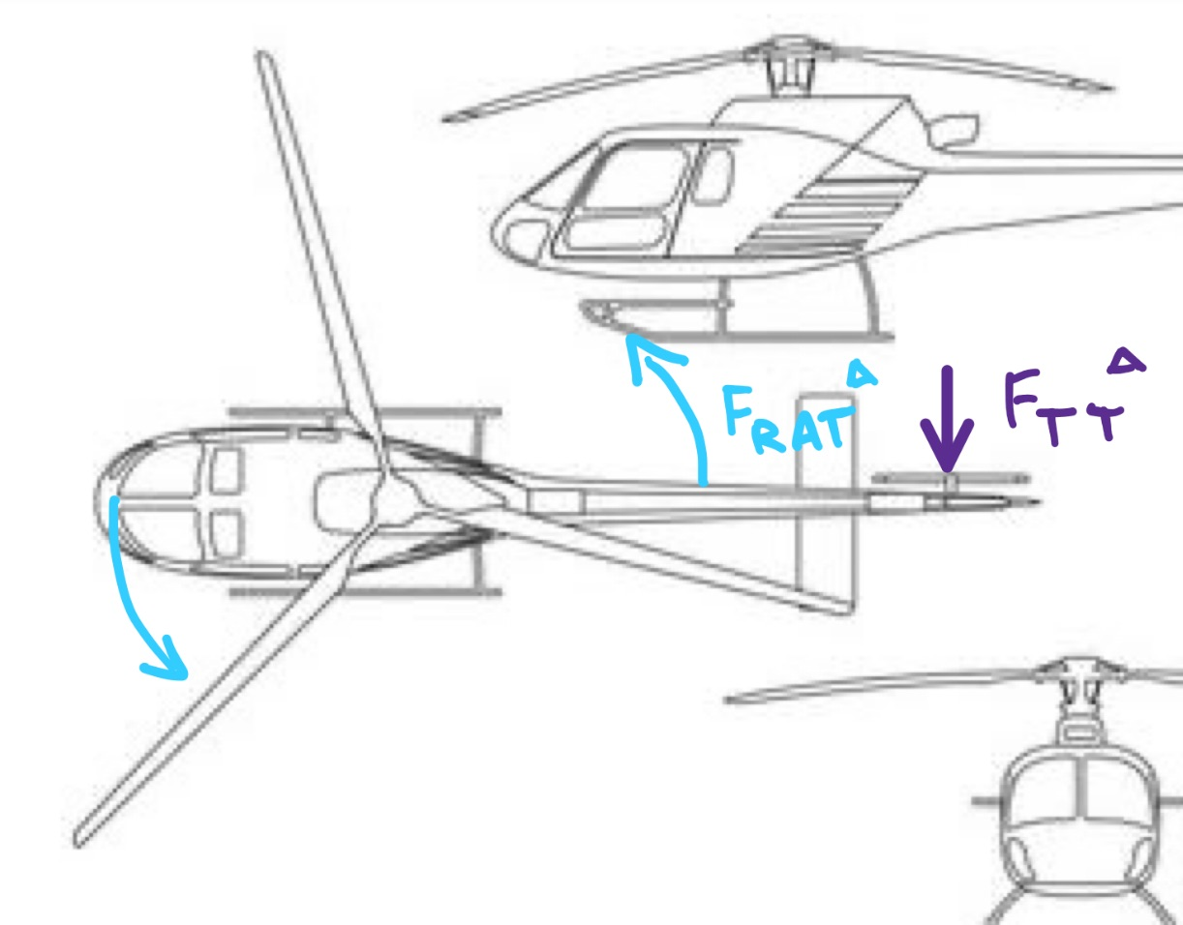
Why doesn’t the helicopter spin?
According to Newton’s third law: without the tail rotor, the body of the helicopter should spin the opposite way of the rotor.
However, the tail rotor produces an equal force that prevents the helicopter from spinning.

Slide 6
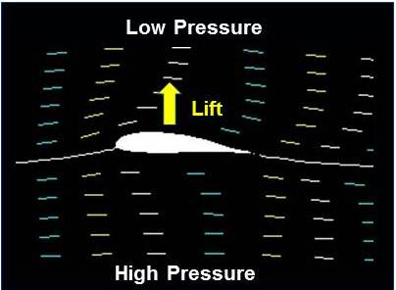
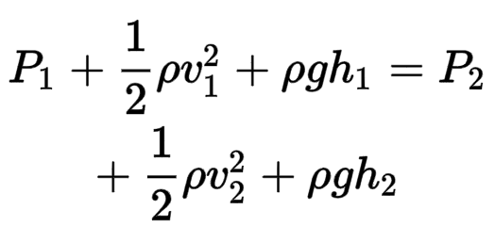
Lift (Bernoulli’s Principle)
The wings are shaped in such a way that air travelling over the top moves faster than air travelling below the wing. According to Bernoulli’s principle,
this causes the pressure to decrease above and increase below the wing. This difference causes lift.
Cross Section of Helicopter Blade
The lift equation is given by:
F_{L}=½(ρ(v^2)S_{ref}C_{L})
Where ρ = density of air, v = velocity of blades,
S_{ref} = area of the blades, C_{L} = coefficient of lift (typically obtained through experimentation but can be estimated) - affected by blade shape and angle of attack (AOA)

Slide 7
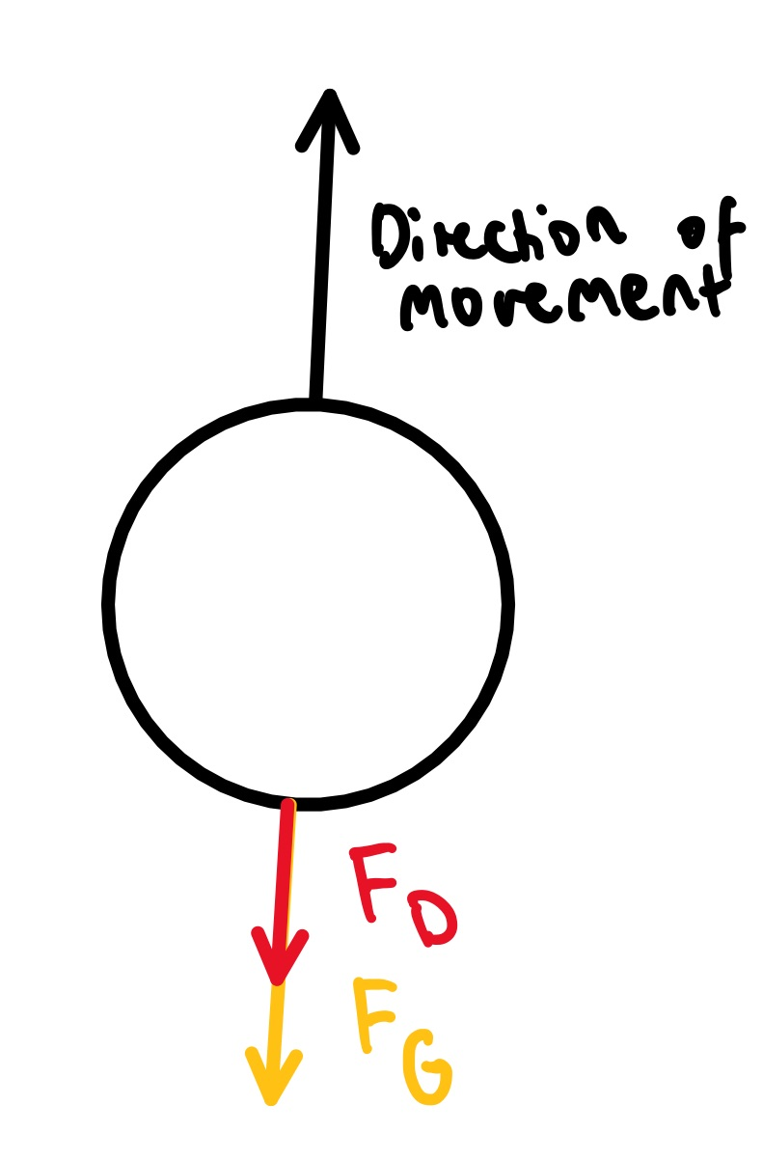
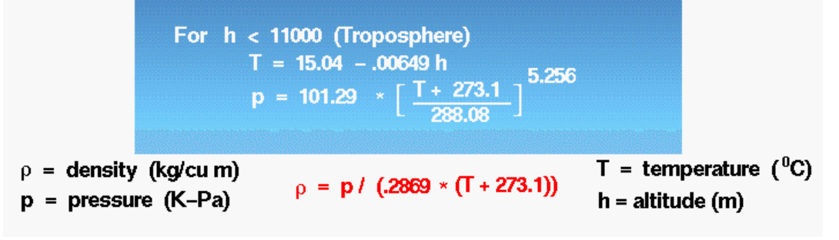
Air Resistance and Weight
F_{G}=G(m₁m₂)/r^2
Where G = 6.67*10^-11, m1 = mass of helicopter, m2 = mass of Earth, r = distance from centers of Earth and helicopter
F_{D}=½(ρ(v^2)C_{D}A)
Where ρ = density of air, v = velocity of helicopter, C_{D} = coefficient of drag (typically obtained through experimentation but can be estimated), A = cross sectional area of helicopter
-> Can calculate air density as a function of height

Slide 8
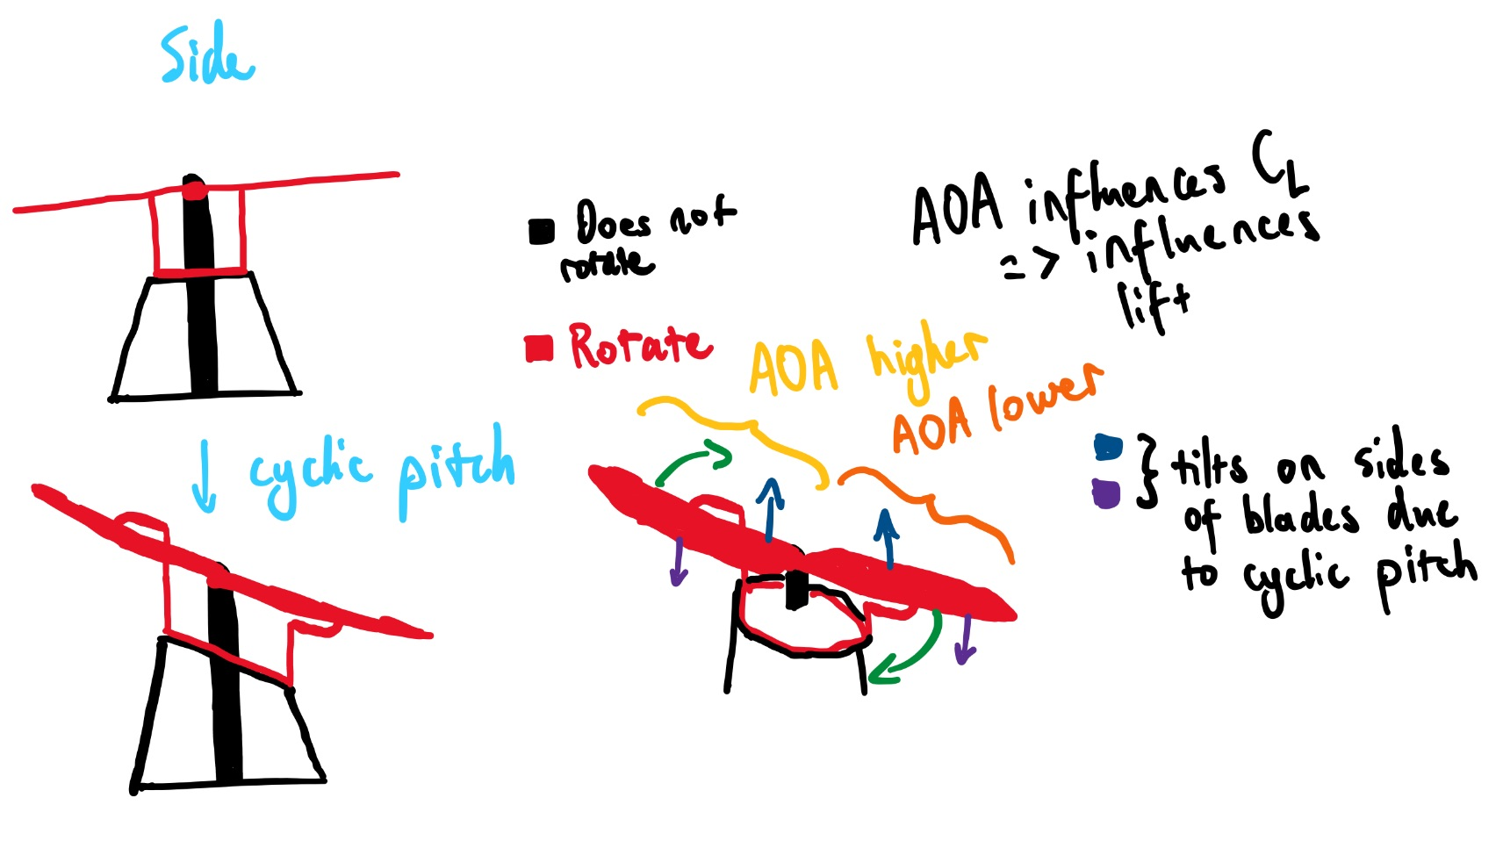
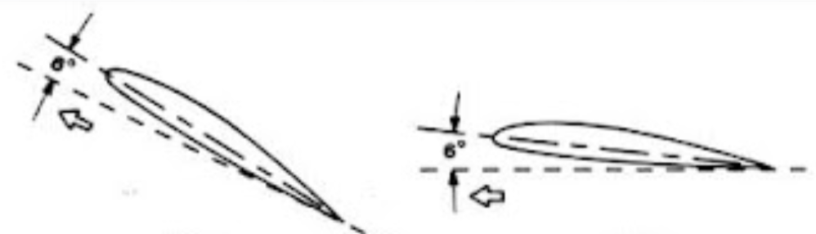
How does the helicopter move?

Slide 9
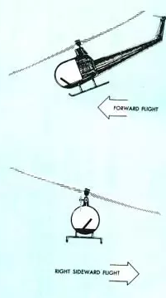
Following the blade (FR):

Slide 10
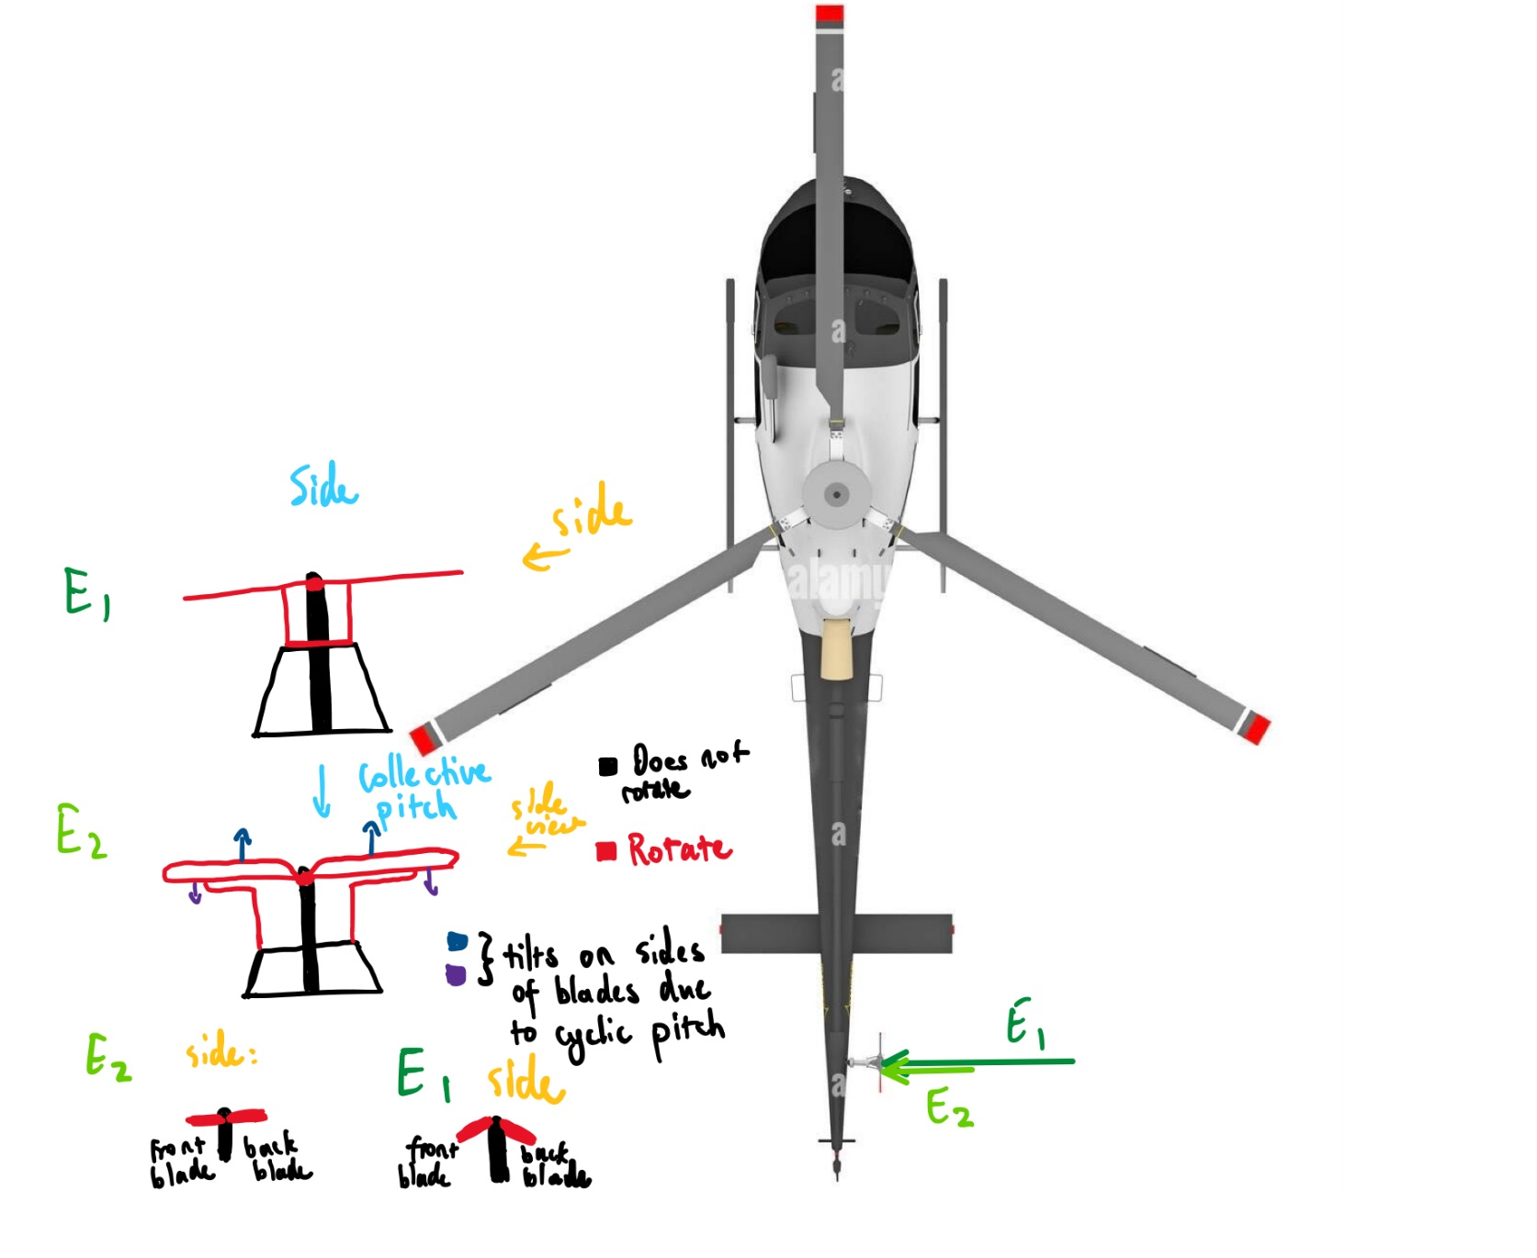
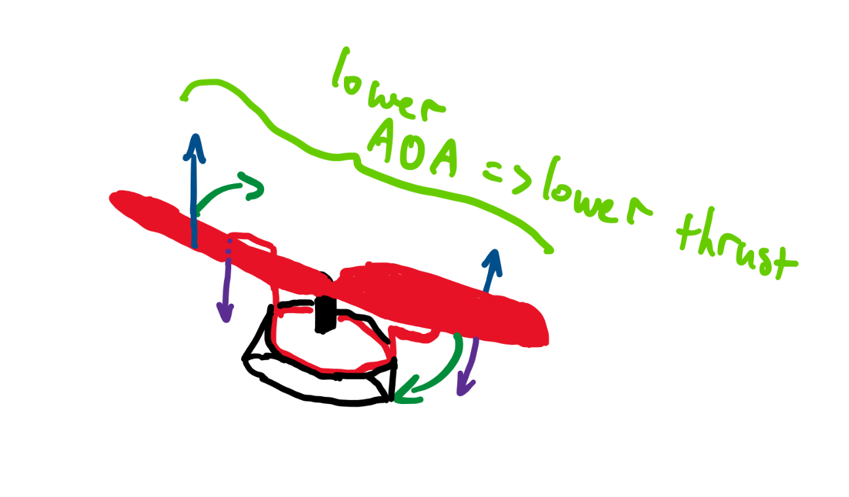
How does the helicopter turn?
Tail Rotor:

Slide 11
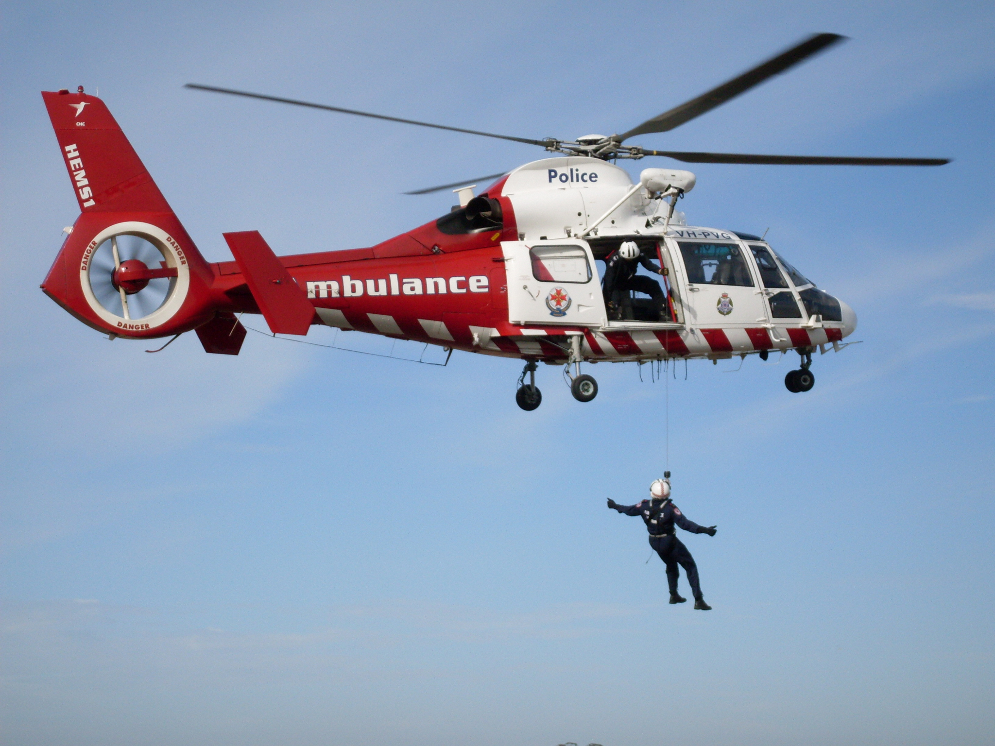
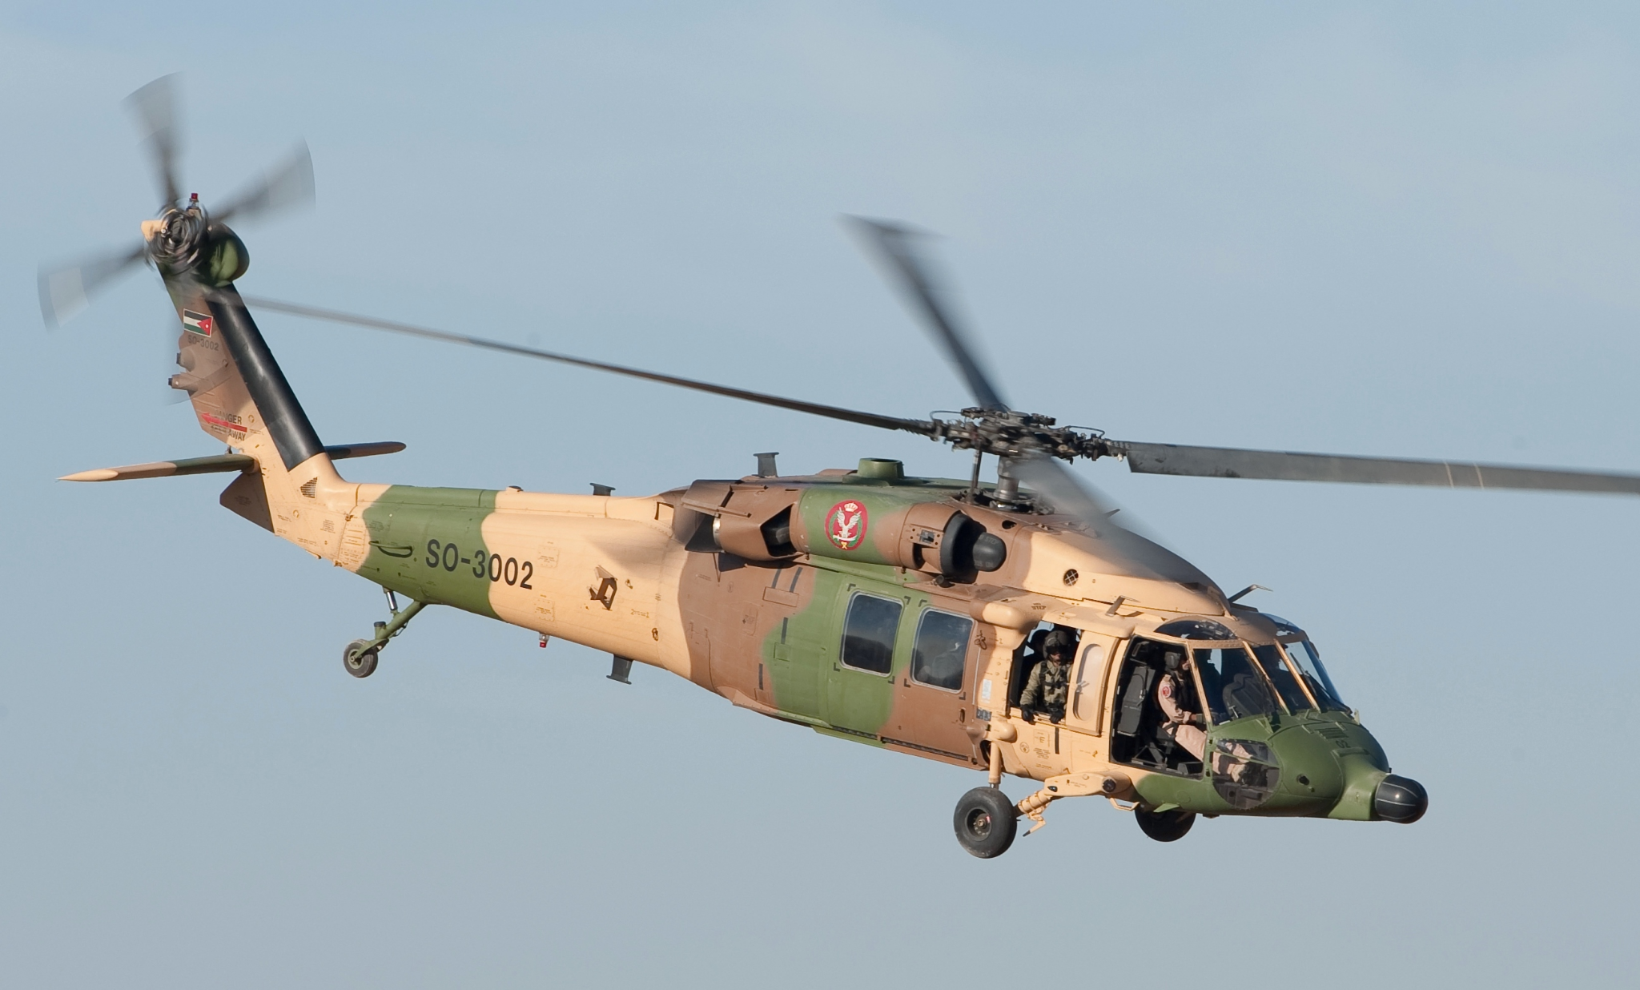
Impact & Application
Currently, helicopters are used in:
Emergency Services: police surveillance, medical transport of patients or transplants, firefighting, search and rescue, mountain rescue.
Military: spy drones, attack helicopters, special operations.
Commercial: transport of people and packages, tourism, drones.
Agriculture: applying fertilisers, pesticides, and herbicides.
These applications involve both life saving and life improving scenarios. Helicopters have revolutionised many different industries and made many jobs much more efficient.

Slide 12
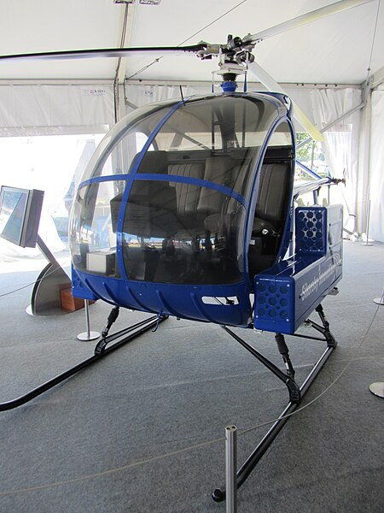
Research & Future Applications
With the continually increasing population, single position take off and landings will become more and more advantageous due to the need for space. Companies are working on autonomous helicopters to make operations safer and more efficient. There is also research being done on electric propulsion to minimise environmental impact. The military is currently working on versatile helicopters with advanced capabilities.

Slide 13
Exam Question
Find the rpm required for a 800kg helicopter to hover at sea level if:
V = velocity at the middle of each of the blades 10m (diameter) blade.
The width of the blade is 0.35m.
The coefficient of lift for the helicopter is 0.12.
((rpm/60)*2*pi*r = velocity at outermost section of blade)
(You may need to search some things up)
F_{L}=½(ρ(v^2)S_{ref}C_{L})

